Slide 1
KOM Mentorship Orientation
Updated: February, 2025 by Suzanne Olive

Slide 2
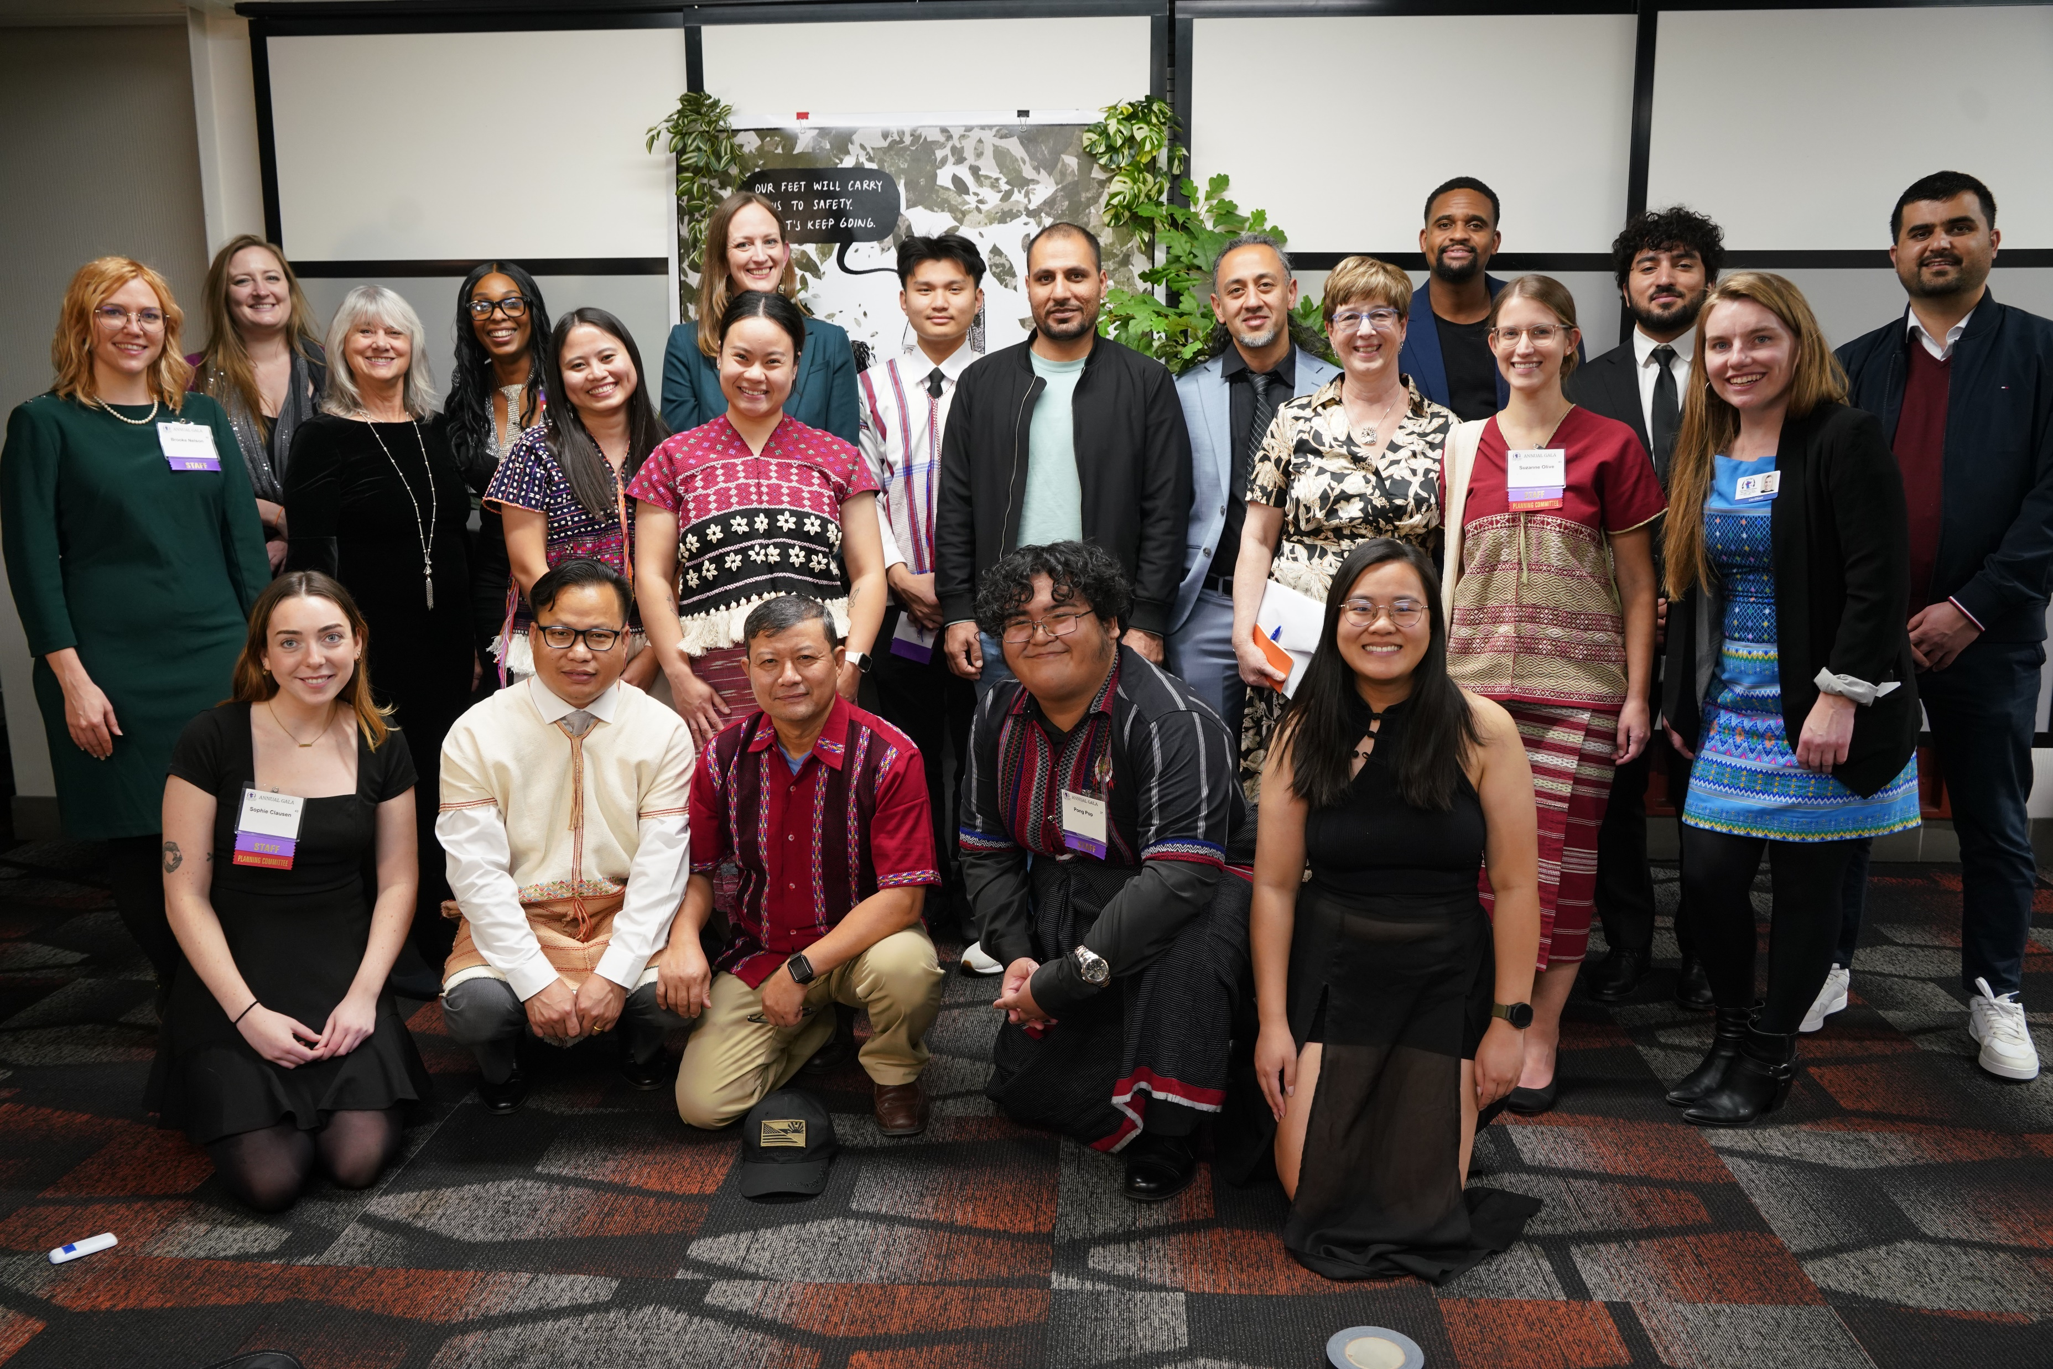
KOM Overview
Notes:
First Social Service agency in US started by Karen refugees from Burma

Slide 3
Our Mission
To build on the strengths of refugee and immigrant communities and remove barriers to achieving economic, social, and cultural wellbeing
Our Community
Over 20,000 Karen and other refugees from Burma live in Minnesota - largest Karen community in the country.
Our Programs
Serving over 3,000 each year in Employment, Social Services, Community Health, Youth Development, and Walk-in services.

Slide 4
KOM Programs
Five main program areas…
Employment
Social Services
Community Health
Youth Development
Walk-Ins

Slide 5
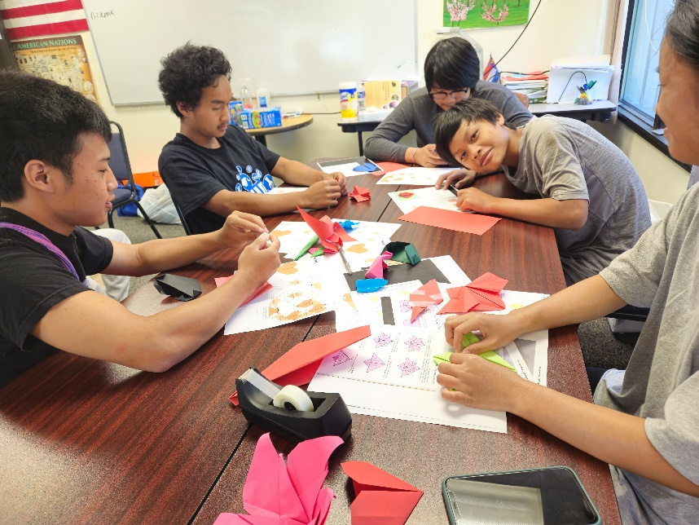
KOM’s After-School Programs
We partner with Saint Paul Public Schools. This year we are working at:
Washington Tech Magnet Middle & High School
Como High School
Ashley Daniels
Youth Programs Manager
Adaniels@mnkaren.org

Slide 6
KOM’s After-School Programs
The program offers…
Knya’Ni Club:
Academic support, mental health workshops, leadership training, field trips, cultural enrichment
What’s Next:
College & Career exploration and readiness
Students are mostly Karen and Karenni age 12-21 years old

Slide 7
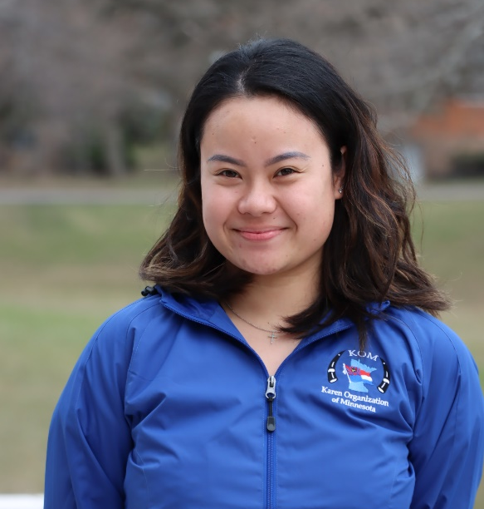
KOM After-School Staff
Mular Lerpwel
What’s Next
Mlerpwel@mnkaren.org
Pong Pop
Knya’Ni Club
Ppop@mnkaren.org

Slide 8
After-School Program Schedule
School/Day | Monday | Tuesday | Wednesday | Thursday
Como 3-5pm | Staff: Pong Pop High School Knya’Ni Club | Staff: Mular Lerpwel What’s Next | Staff: Pong Pop High School Knya’Ni Club (Tutoring Day) | Staff: Mular Lerpwel What’s Next
Washington 3-5pm | Staff: Mular Lerpwel What’s Next | Staff: Pong Pop High & Middle School Karen Club | Staff: Mular Lerpwel What’s Next | Staff: Pong Pop High & Middle School Karen Club (Tutoring Day)

Slide 9
What is a mentor?
A mentor is:
A mentor is not...
Friend
Guide
Listener
Confidant
Encourager
Strengths-finder
Resource broker
Parent/Guardian
Social Worker
ATM
Babysitter
Disciplinarian
Notes:
Now that we’ve talked a bit about KOM, let’s pause for a minute and make sure we are on the same page about the term “mentor”
Ask Group: What words come to mind when thinking about the term mentor? When you think of people who were mentors in your life, what were things they did that made you consider them a mentor?
Brainstorm (2 groups): One group brainstorms list of "A mentor is..." And one group brainstorms list of "A mentor is not..." Groups share list with the whole group.

Slide 10
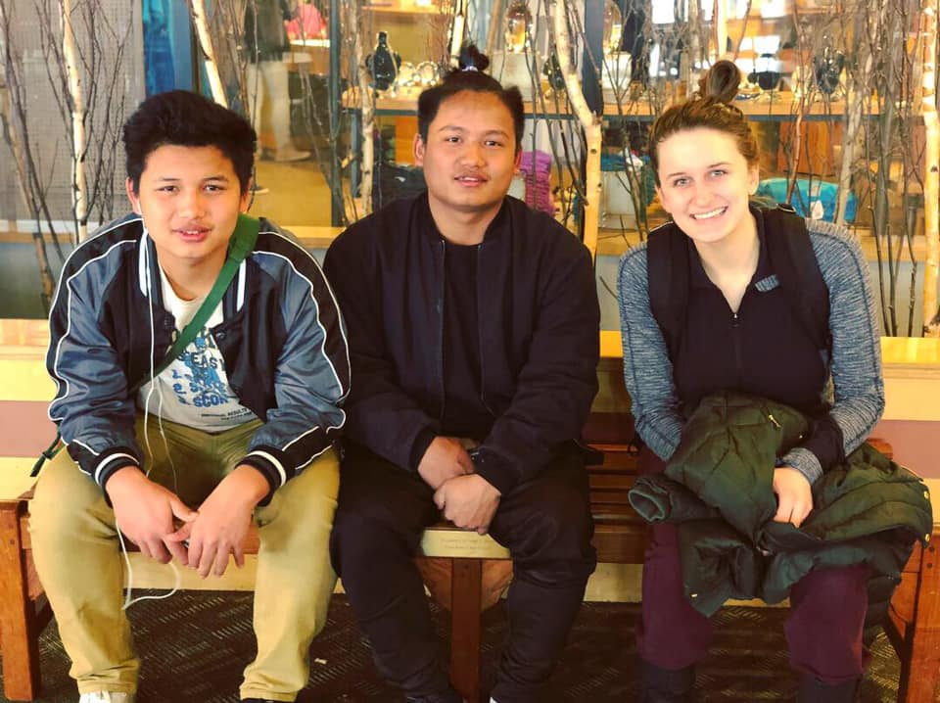
Mentoring Goals
Developing English language and reading skills
Adapting to American culture while maintaining the mentee’s own culture
Developing social and life skills
Providing emotional support
Serving as an advocate and guide to basic activities (such as using public transportation, using a library, etc.)
Developing college or workforce preparedness skills
Providing opportunities to just relax and have fun! ☺

Slide 11
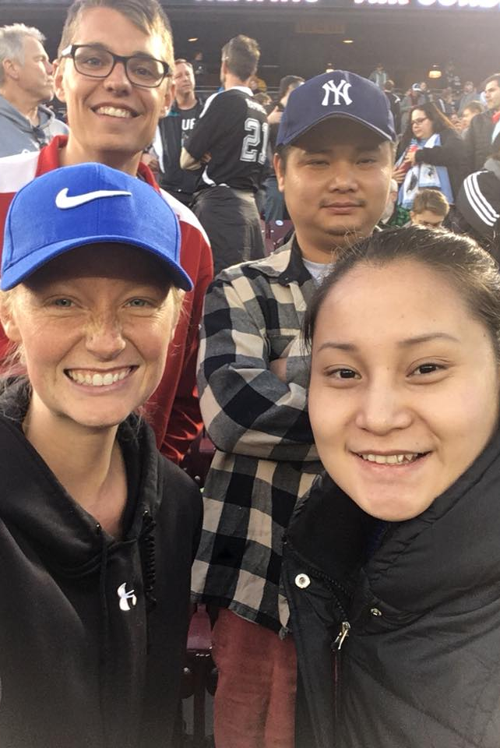
Mentor Responsibilities
Attend pre-match training
Meet with mentee on a weekly basis
Commit to the program through May
Check in with program staff
Monthly phone check-ins (pick a group main contact)
Changes to address/contact info (also mentee)
Problems/frustrations/changes in match
Successes/accomplishments
Follow program policies and procedures

Slide 12
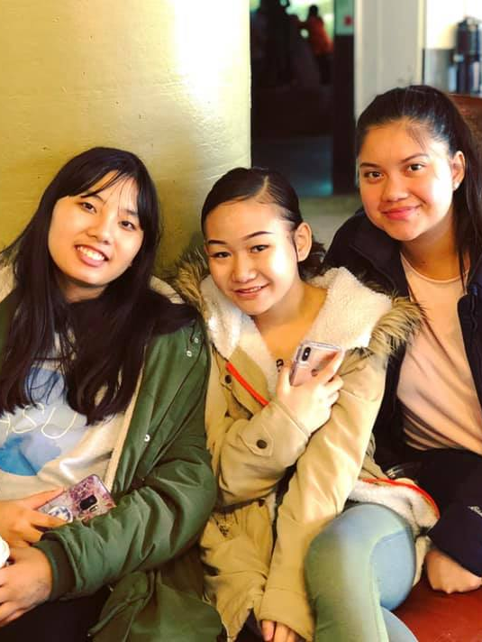
Program Polices/Procedures
Transportation
Approved Activities
Drug/Alcohol
Weapons
Inappropriate conduct
Overnights/Out-of-Town Travel
Confidentiality
Gift Giving
Communication
set up group texts/messages for communicating
maintain appropriate boundaries
Closure
Mandated Reporting

Slide 13
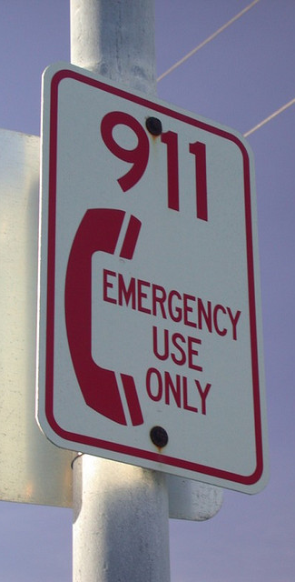
Mandated Reporting
KOM mentors and staff are required to report observed abuse or neglect
It is not the role of the reporter to determine if abuse or neglect occurred, only to report it
Reports are confidential
Procedure:
If it is an emergency, contact 911 then program staff
If it is not an emergency, contact program staff and they will guide you through reporting process

Slide 14
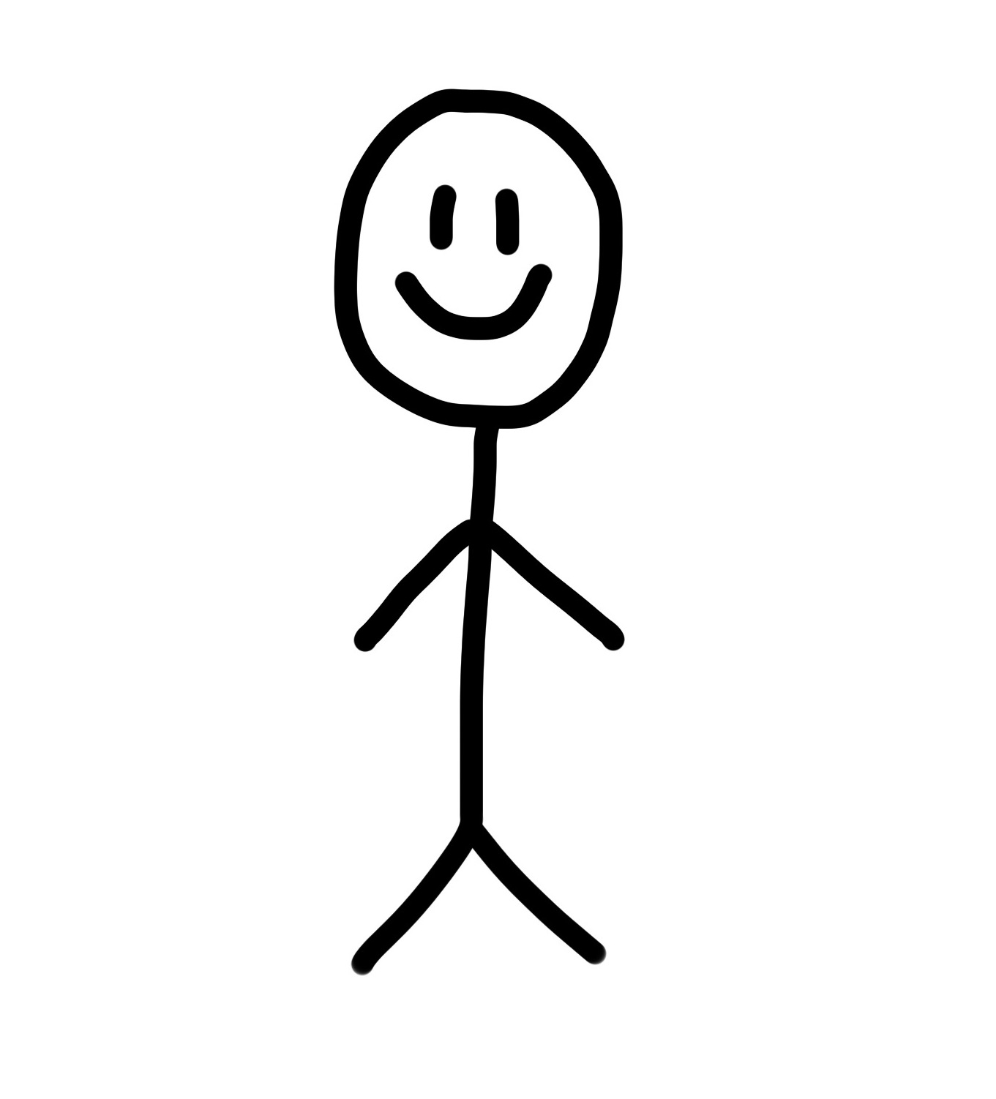
Characteristics of a Good Mentor
Empathic
Friendly
Culturally Aware
Trustworthy
Creative
Strengths-based
Appropriate expectations
Healthy boundaries
Good Communicator
Notes:
Now that we’ve covered the program ‘nuts and bolts’, let’s transition to the “HOW” part of being an effective mentor. In this part of the training, we will be discussing some strategies to having a great match experience
Review each characteristic:
Empathetic – ability to empathize and understand the experiences of a Karen youth
Culturally aware – ability to appreciate the norms, culture and expectations of a Karen family
Creative and friendly – ability to create meaningful and fun experiences for a Karen youth
Trustworthy – ability to provide support for a Karen youth with confidentiality
Strengths-based
Appropriate Expectations – change doesn’t happen right away. Trust takes time to develop. Conflicts and frustrations may/will arise.
Good Communicator – with mentee, parent, program staff
*Idea -Each person brainstorms what each of these attributes (or a few of them) might look like and/or what might happen if they didn’t do those things
Let’s talk about a few of these in more detail…

Slide 15
Mentoring Life Cycle
Notes:
Have you ever had the experience where your expectations didn’t match what really happened? This happens to all of us….
One way to clear up expectations in the match experience is by looking at a typical match life-cycle
Helpful in knowing what is normal, what is to be expected
Each one of these quadrants may vary in size/length (for example, some youth people may take much longer to trust than others)
When conflict comes up or you hit a rough patch, how might you address it? (direct/indirect, “I” statements, problem solve together, etc)
Important to stick through these stages – expectation is at least a year. We are here to work through the stages with you.
Before we move off of this slide…can any one guess why closure is important?
Closure is a critical component to your match relationship. It might feel strange to talk about it before you have even met your mentee, but thinking about how the match will end is part of developing a healthy relationship and setting expectations. All matches come to an end – some in predictable/planned ways, and others are more unplanned, or unpredictable. Whatever the reason for the closure, we try to wrap up the experience in a healthy, positive way. That might involve reflecting back on accomplishments, favorite moments, and/or providing a sending for each other. When there isn’t healthy closure at the end of a match, or when matches close prematurely, we can actually do harm to the young person. And, clearly, no one wants that.
Takeaway: Thinking about your match through the lens of the typical match life cycle will help you set realistic expectations for this experience. But it doesn’t end there – it will also help you to think through your expectations for participating in this program, and check back in with those from time to time. This is also a great topic to discuss with program staff as your relationship progresses.

Slide 16
Best Practices for Mentoring Karen Youth
Take the time to LISTEN
Consider grief or loss
Encourage maintenance of Karen culture as they adapt to living here
Support academic success and educational process
Be flexible and creative
Recognize/respond when your mentee exhibits behaviors of concern
Help your mentee reach their goals
Notes:
Take the time to LISTEN – to really hear the experiences, hopes and challenges of the mentee you are working with.
Remember that your mentee who is likely still transitioning to this country may be dealing with loss – of their homeland, family or friends.
Encourage and support your mentee in maintaining the cultural, religious, and family values of their country of origin while simultaneously helping them adapt to American culture.
Support your mentee’s academic success and educational process, encouraging them to stay in school and seek help when needed.
Be flexible and creative in meeting your mentee and family’s needs.
Recognize and respond when your mentee exhibits behaviors of concern that might be indicative of depression, drug use, inability to manage anger and aggression, involvement with anti-social groups such as gangs, or breaking the law.
Develop activities to help your mentee reach their goals for the future.

Slide 17
Our Youth’s Strengths & Challenges

Slide 18
Strengths and Assets
Cultural and family values
Bilingualism
Sense of resiliency and flexibility
Ability to navigate through cultural demands
Value of education
Respect elders and teachers
Athleticism
Challenges Faced
Exclusion
Poverty
Separation
Adjustment
Traumatic experiences
Discrimination/bullying
Disconnect from education
Intergenerational conflict
Drug use/gangs

Slide 19
Parent-Child Role Reversals
“Many [Karen] youth are faced with parent-child role reversals because they speak and understand English much better than their parents. When this happens, a young person might be placed in the position of translating basic needs for their parents – to teachers, doctors or family advocates. This responsibility has the potential of changing parent/child dynamics.” (Mentoring Immigrant & Refugee Youth, pg. 6)
Notes:
Another potential risk is in Parent-Child role reversals.
*How would this impact the mentor? What should the mentor be aware of? This would be a good case study scenario.

Slide 20
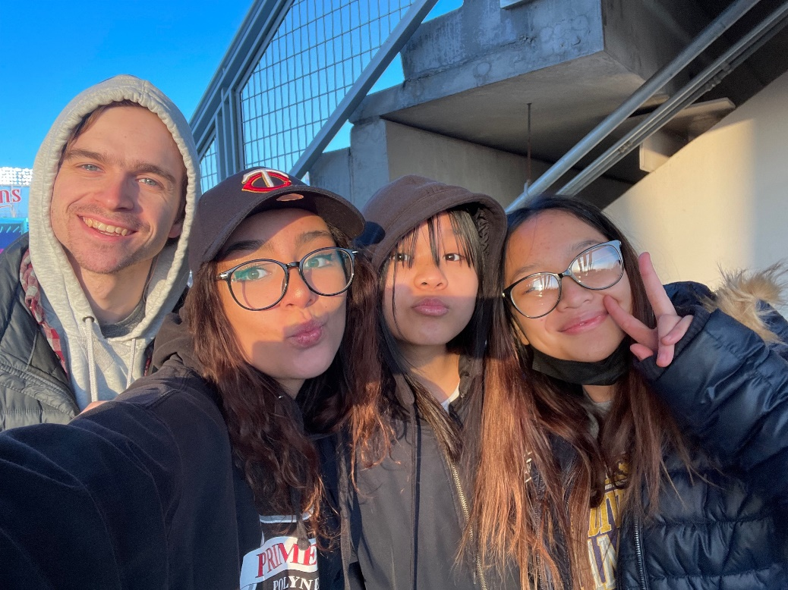
Mentor Reflections
“Talking and opening up got easier. Both of our mentees were very reserved and shy the first few meetings. [Mentee’s name] has been reaching out to us about what’s going on in her life. She asked us for tips about her job interview, and what it’s like living at college. [Mentee’s name] is a little more comfortable to joke around and show us some drawings now, and he asks us more questions.”
“I simply enjoyed just spending time with the students, laughing, and playing games. Once the students came out of their shell it was really fun!”

Slide 21
What can I do with my mentee in-person?
Spend time doing homework, playing a game, or another activity
Walk to a park, go sledding, or other outdoor activities
Attend a free community event, visit a local library or rec center
Play soccer, volleyball or other sports
Visit a college or university they might be interested in
Visit a Karen store/business or get lunch there
Tickets for kids - complimentary tickets available for sports games, museum visits, theatre performances, etc.
Notes:
*Idea – provide list of activities that they can do and any discounts available to KOM matches
Homework help
Visit extended family
To church
Karen market for lunch
Cooking together
Bowling

Slide 22
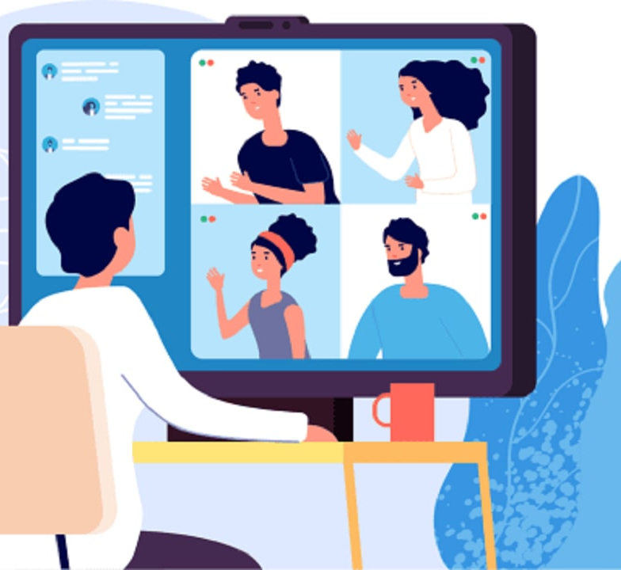
Virtual Mentorship
Some mentorship activities can be held virtually if needed
Ways of Connecting
Google Meet
Facebook
Phone
This Photo by Unknown Author is licensed under CC BY-SA-NC

Slide 23
What can I do with my mentee online?
Help with homework, read books, or do other educational activities online
Learn about each other’s favorite music and share songs or dances
Play virtual soccer, volleyball or other sports games
Do a virtual tour of a college, university, library, or museum
Do a simple art or craft activity together (i.e. design your own avatar)
Share about your favorite foods or traditional dishes
Do an exercise challenge every week and check-in on your progress
Notes:
*Idea – provide list of activities that they can do and any discounts available to KOM matches
Homework help
Visit extended family
To church
Karen market for lunch
Cooking together
Bowling

Slide 24
SPPS Calendar
No School:
Monday February 17th – Presidents’ Day
Friday March 7th – Professional Development
March 31st – April 4th – Spring Break
Friday April 18th – Professional Development
Monday May 26th – Memorial Day
Last Day of School
Tuesday June 10th – Last Day of School

Slide 25
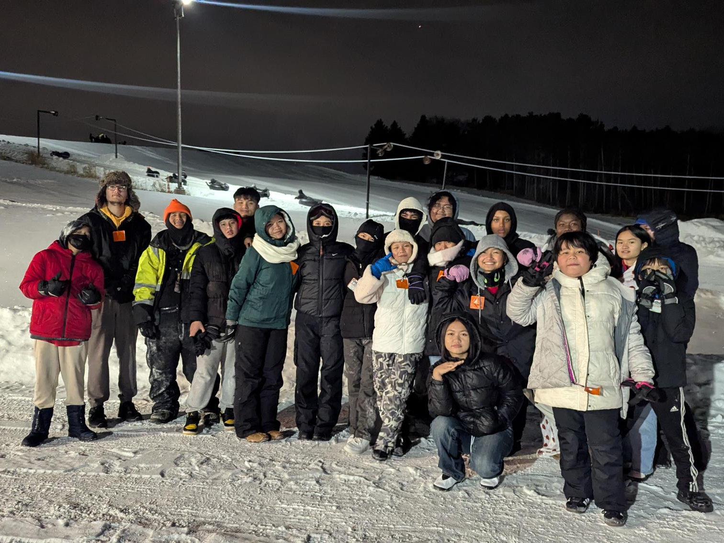
Field Trip – Presidents’ Day Monday 2/17
Details TBD – let me know if you’re available!

Slide 26
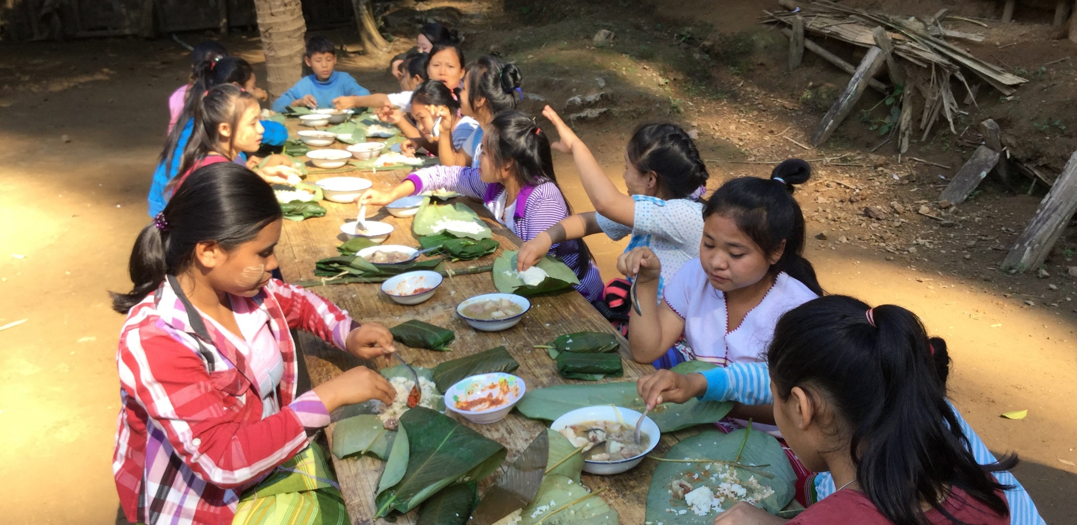
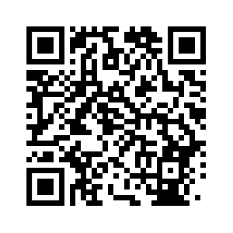
Karen Culture Presentation with KOM
Friday, February 21st 11:00am – 12:30pm on Zoom
RSVP on our website or scan the QR code

Slide 27
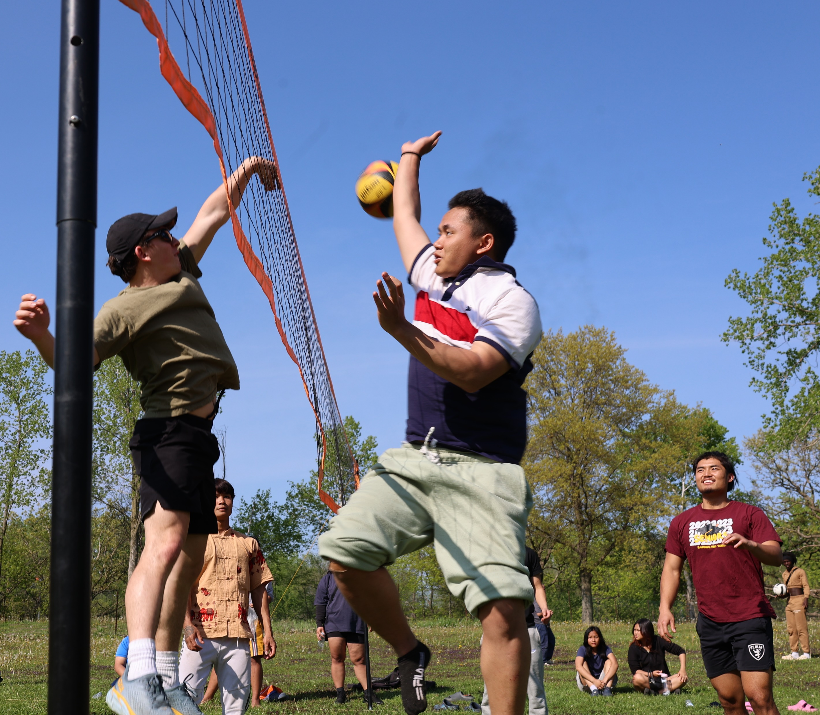
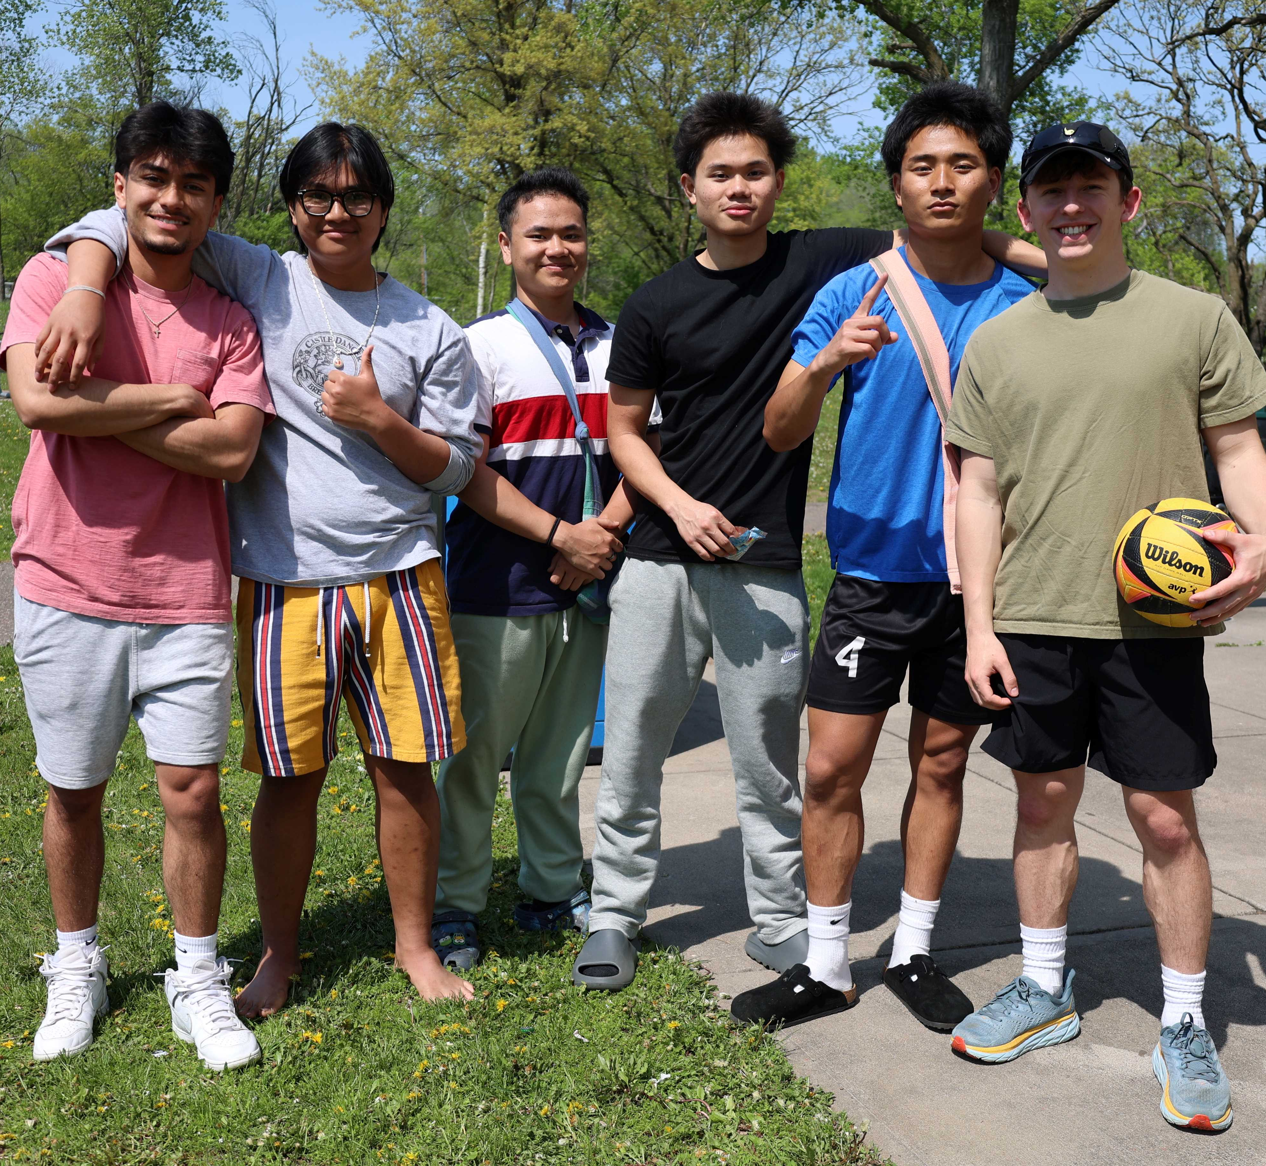
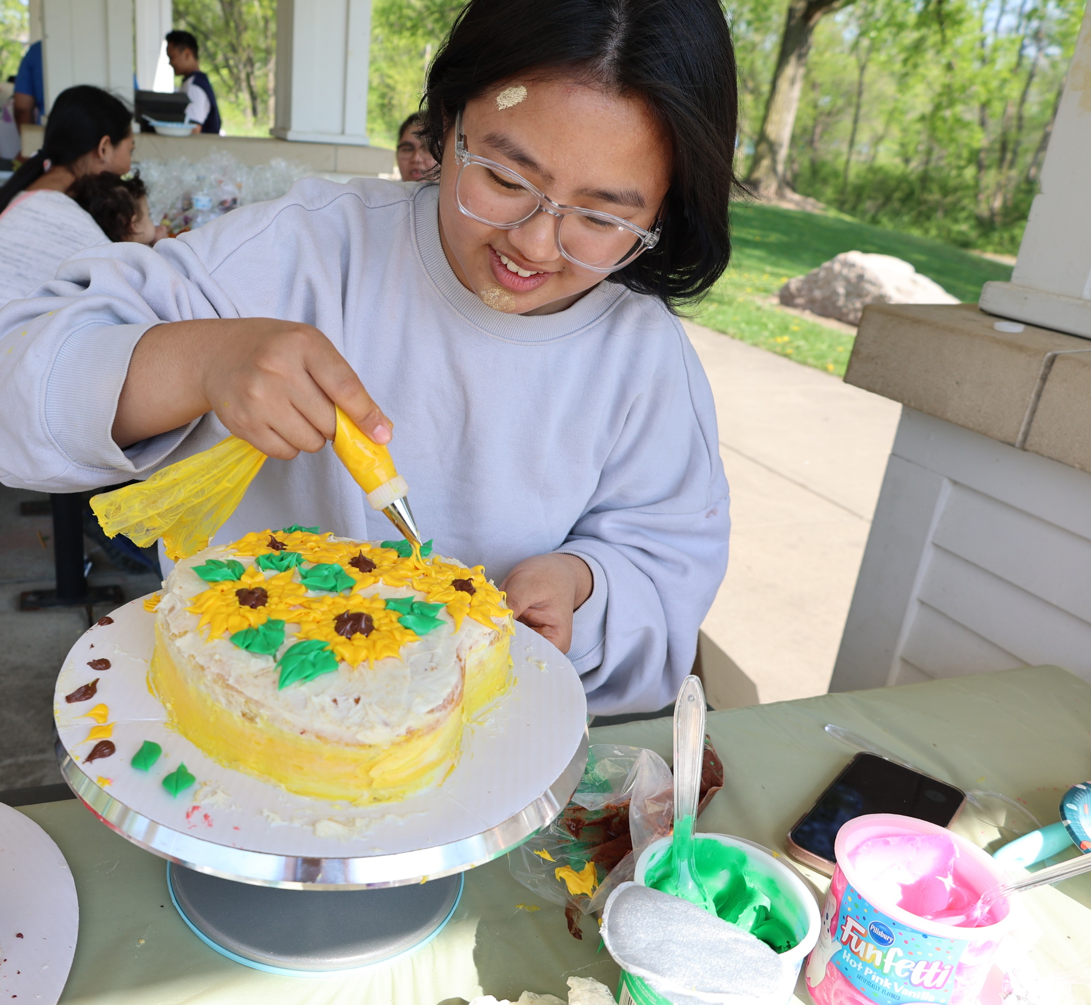
May Picnic
End of the year celebration
At a St. Paul public park
Mid-May
Food and sports tournament

Slide 28
KOM Volunteer Handbook
Consent & Background Check Forms, Motor Vehicle Info

Slide 29
As a KOM Volunteer, Please Do Not:
Impose
your personal views on politics, religion or other controversial matters
Promote
your own personal or business interests
Involve
yourself in the personal or financial affairs of clients (refer to KOM staff for complex cases i.e. child protection, domestic issues, chemical health, etc.)
Accept
cash from clients (food and other small non-monetary gifts may be accepted)
Collect
clients’ health records
Help
with tax issues
Assist
with legal issues (i.e. child support, divorce, disability claims filing, immigration forms, SSI function & work history reports, etc.)

Slide 30
Consent & Background Check Forms
Photograph Release
Reporting
Confidentiality
Clients/Conflict of Interest
Driving & Background Check
Withdrawal of Consent

Slide 31
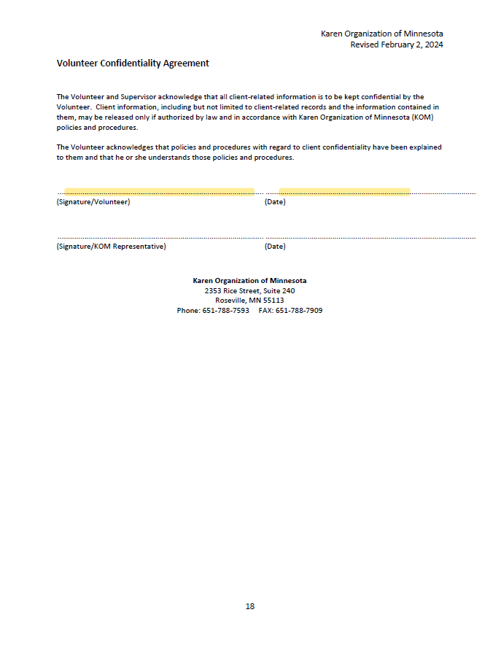

Slide 32
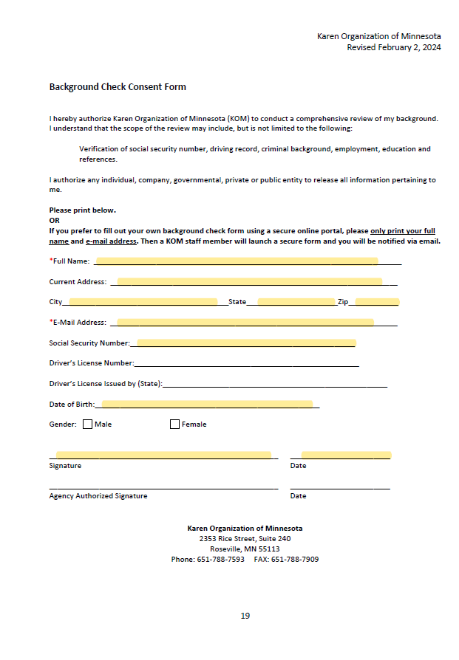
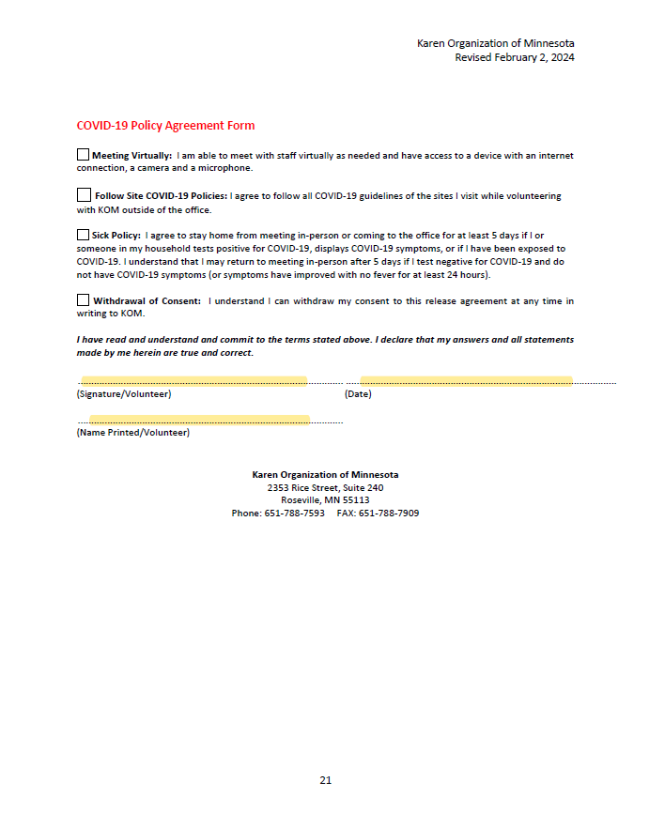

Slide 33
SPPS Forms
Data Privacy Agreement
Consent to Release of Background Check Report
Technology Agreement

Slide 34
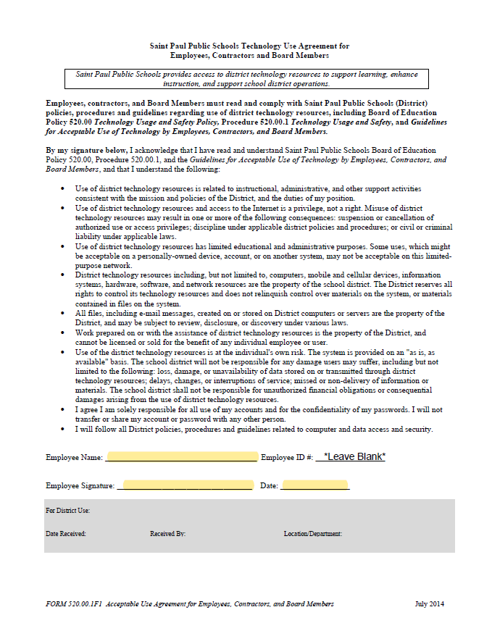
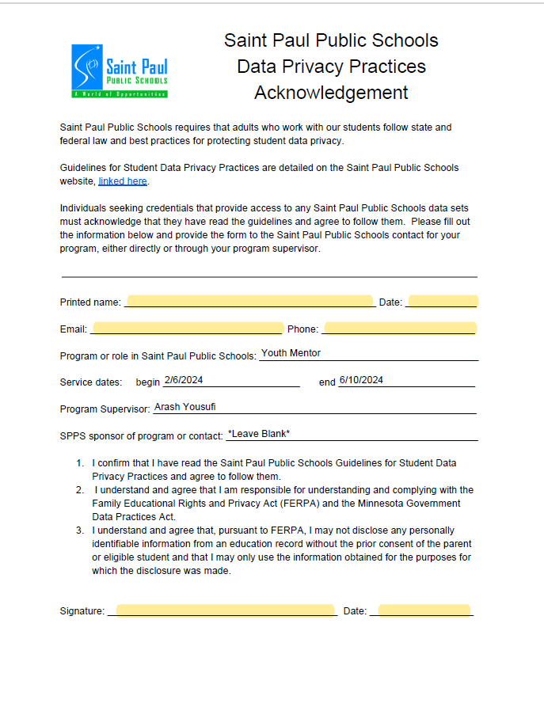
2/6/2025
6/10/2025

Slide 35
If planning to drive students…
Copy of Driver’s License
Copy of Car Insurance
Must include driving info on Background Check

Slide 36
Sick Policy
Masking is optional
Stay home when sick
Follow Site COVID-19 Policies
Stay home 5 days if you or household member tests positive for COVID-19

Slide 37
Logging Hours
KOM’s Online Database: Apricot
Go to apricot’s website (https://apricot.socialsolutions.com)
OR
Send your hours to Suzanne via email or text:
solive@mnkaren.org
651-202-3112

Slide 38
Remember…
You are not alone!
Contact program staff anytime with:
Questions
Concerns/ frustrations
Successes/ accomplishments
Activity ideas
Or just to check in!

Slide 39
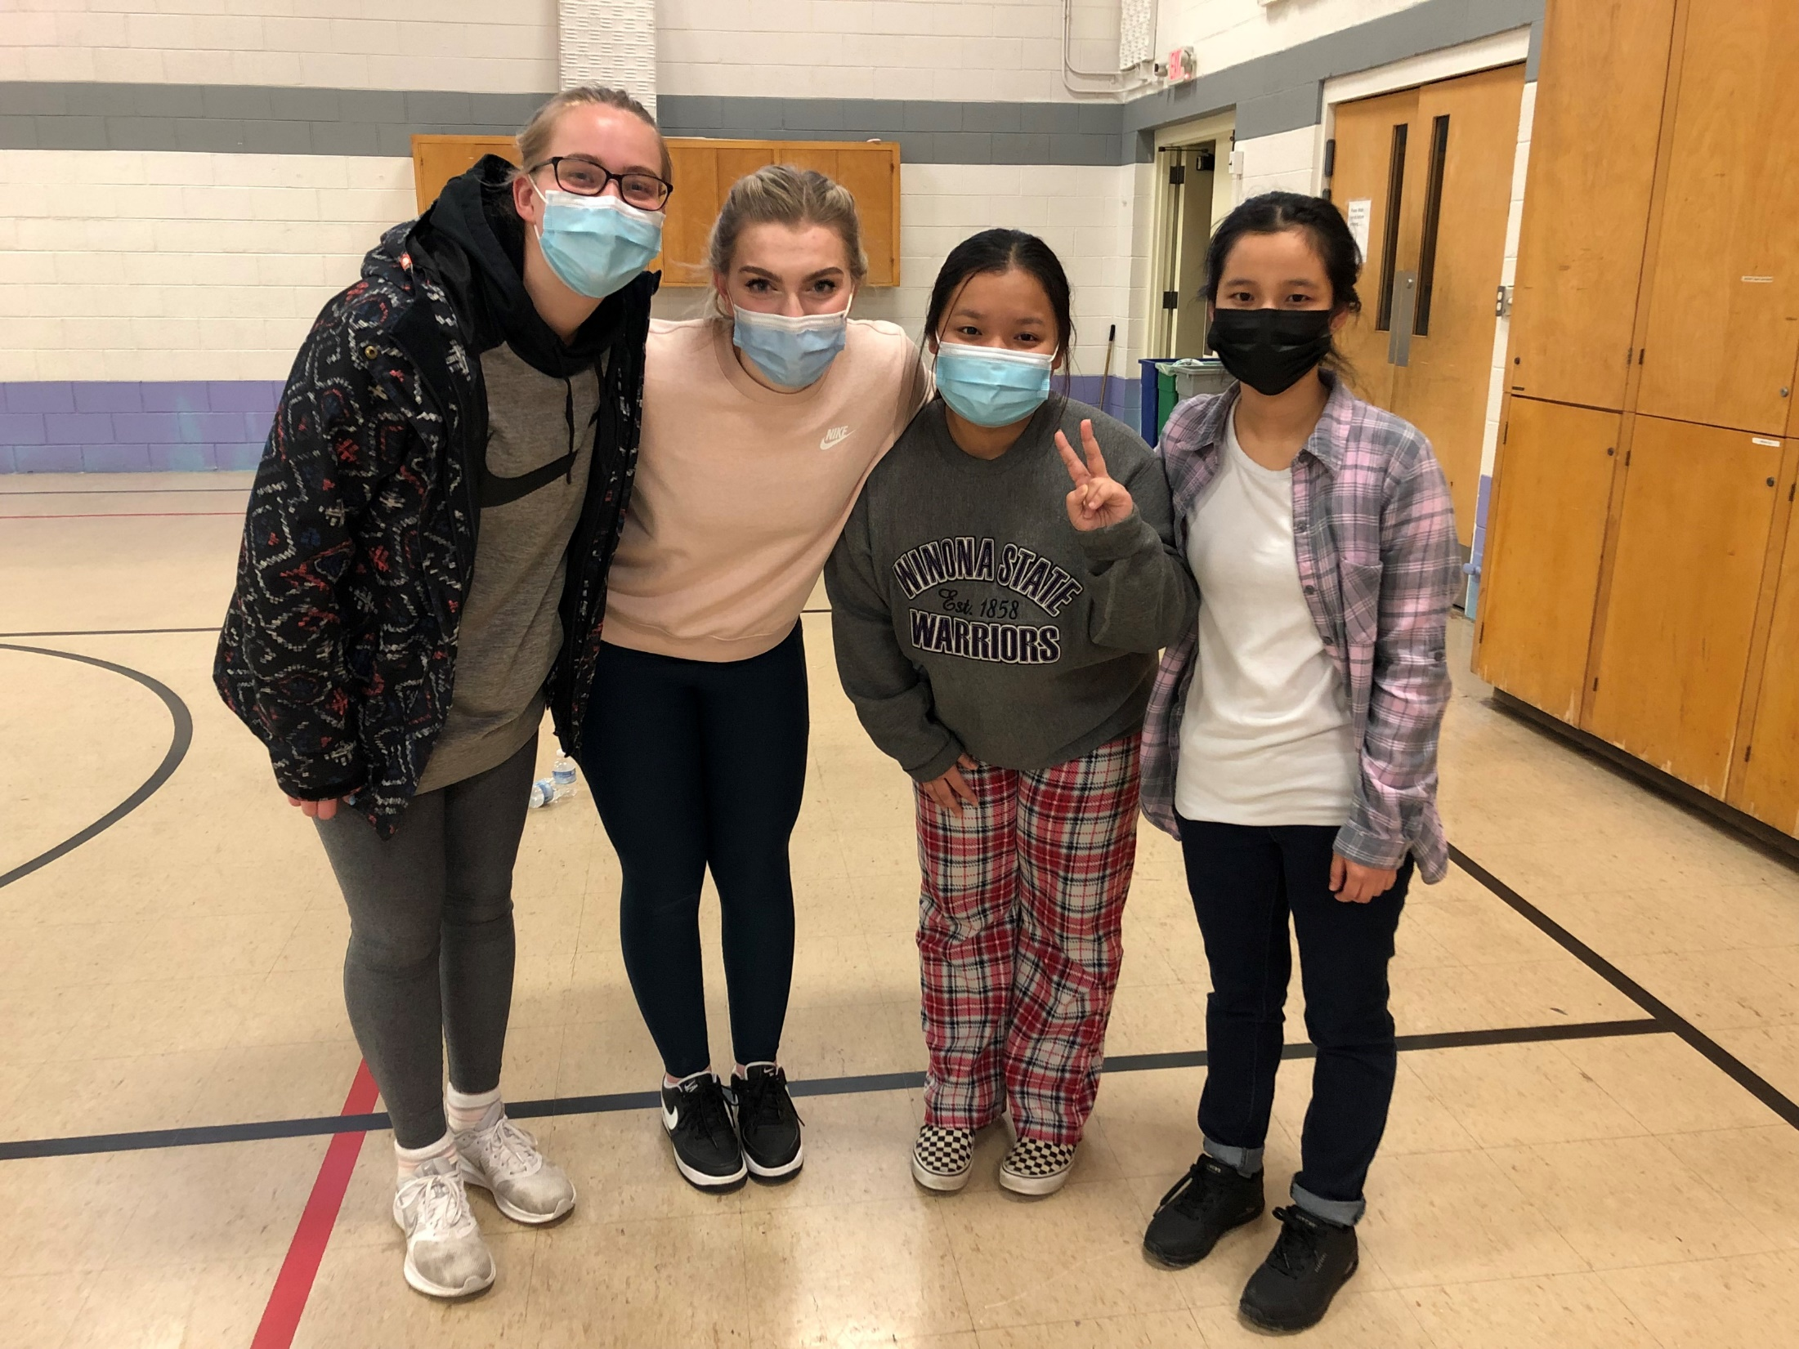
Closing
What is one thing that stuck out to you?
What is one thing that you are challenged to apply?
What questions do you have?
Notes:
Thank them for coming and for their interest in being a mentor!

